Slide 1

Strategic Analysis for the National Medicare Advantage Health Plan
Welcome, Chief Medical Officer!

Slide 2
Our Task
We were asked to use publicly available data to understand where food access challenges are concentrated among Medicare Advantage members. We want to guide you, the Chief Medical Officer, through statistical determination of target quantities, areas, and population subgroups to maximize quality care.

Slide 3
What questions are we trying to answer?
How concentrated is need geographically?
Where should we deploy a food access program?
Which subgroup of the population might be benefited the most?
Which areas are showing overlapping health and food risk access?
How many people will be included? How many might be successfully engaged?
What does projected impact look like?

Slide 4
Low Food Access Data: Food Environment Atlas
County/county equivalent for all 50 states.
Access and Proximity to food store
Number of people in a county who are living more than 1 mile from a foodstore if in an urban area or more than 10 miles from a foodstore if in a rural area.
As a baseline we will use what was measured in Counts and Percents in 2015
Measured for different subgroups: low income, no car, children, seniors. Subgroups are not independent proportions of the total population count, as some subgroups overlap (i.e., low-income senior).

Slide 5

Understanding the Breakdown of Low Food Access Areas
Map of low access areas concentration (based on percents)
Chart showing overall target areas
Understanding overall counts
Map for each subgroup
Chart showing each subgroup (based on percents)
Counts in each subgroup
Notes:
Map of low access areas
Chart showing overall target areas
Map for each subgroup
Chart showing each subgroup

Slide 6
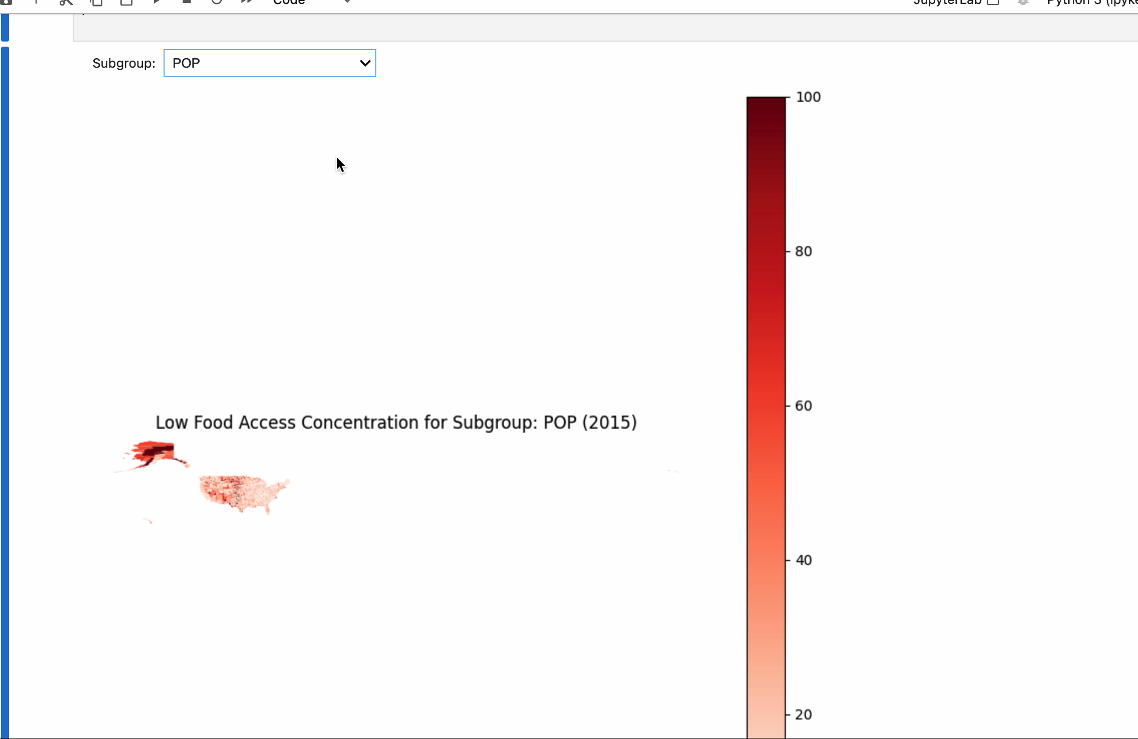
Understanding the Breakdown of Low Food Access Areas
Map of low access percentage in the US.
Subpopulation percentage concentration.
Overall population has low access concentration in the Midwest area, Southwest, and Alaska.
Alaska deeply affected through multiple subpopulations.
Highly affected subgroups contain low-income individuals, seniors, children, the white population concentrated in the Midwest, and the Hispanic population concentrated in the Southwest.

Slide 7



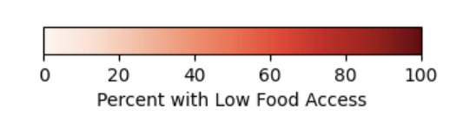
Understanding the Breakdown of Low Food Access Areas(Static Images)
Notes:
Map of low access areas
Chart showing overall target areas
Map for each subgroup
Chart showing each subgroup

Slide 8
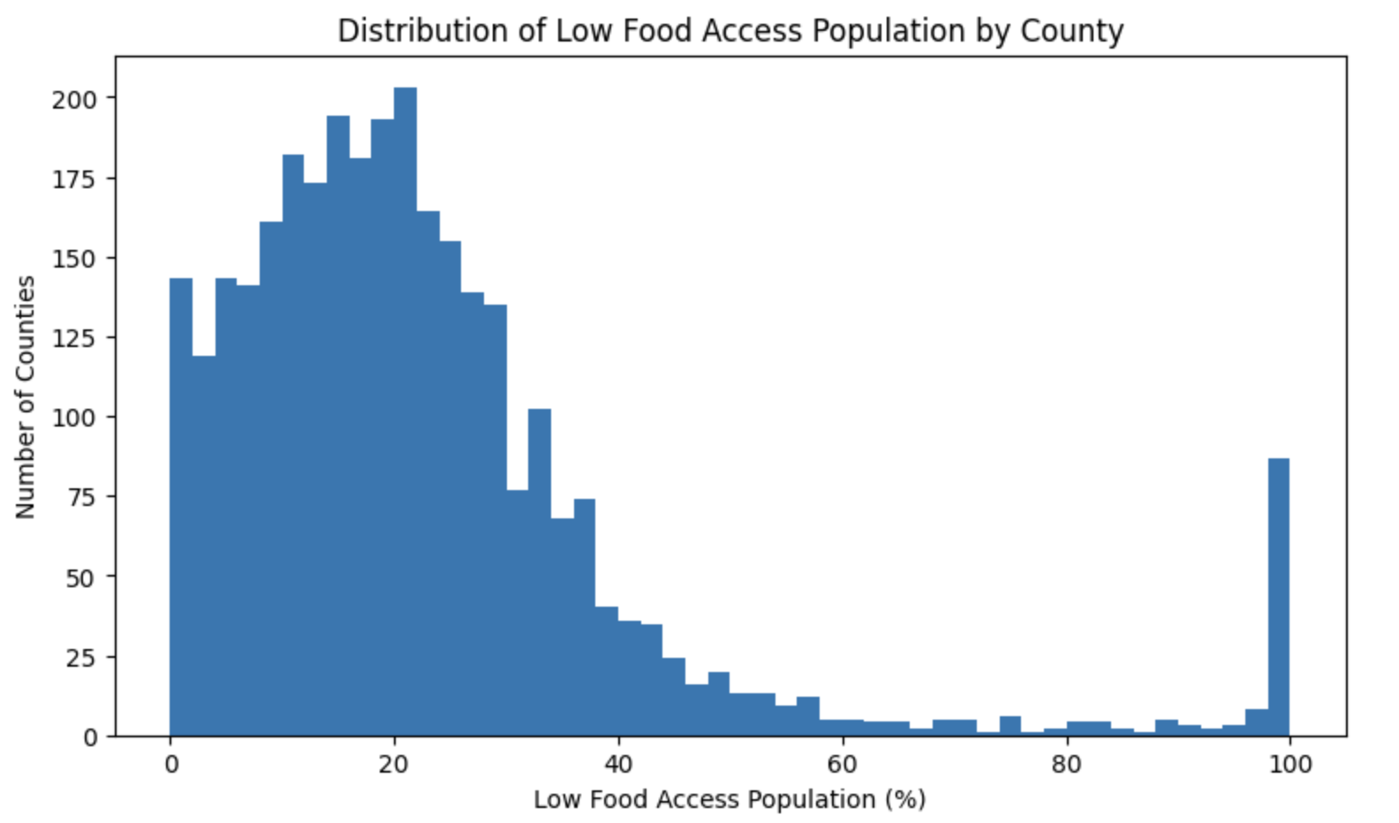
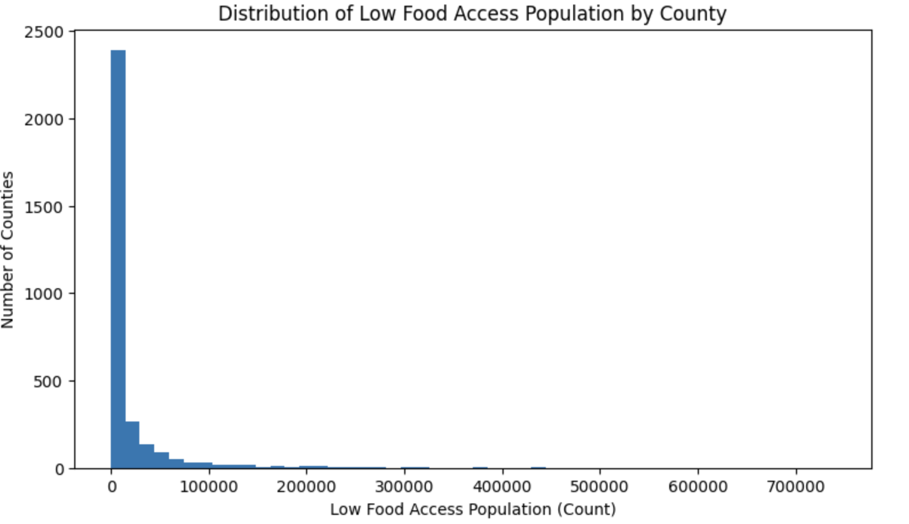
Total Low Access Population Breakdown
Right-skewed distribution of counts and percents, meaning more counties have a lower population/percentage of populations that have low food access.
This means our target counties with high populations of access necessities can be extracted and grouped.
Notes:
Map of low access areas
Chart showing overall target areas
Map for each subgroup
Chart showing each subgroup

Slide 9
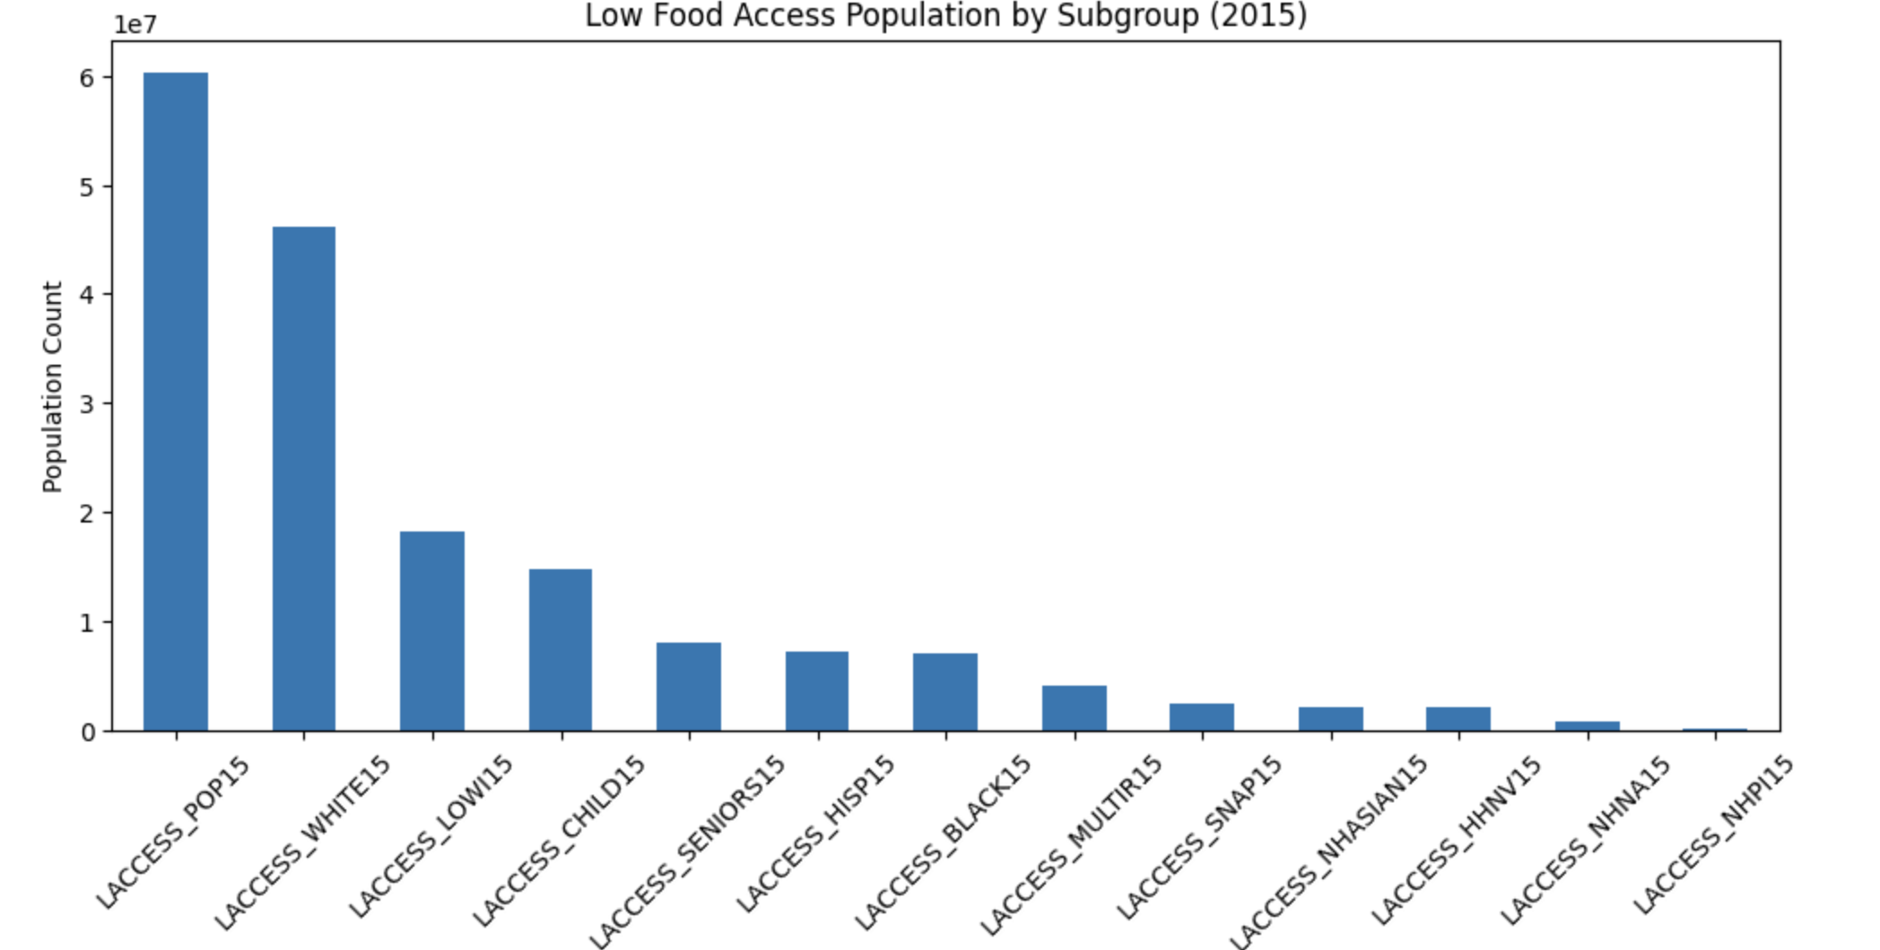
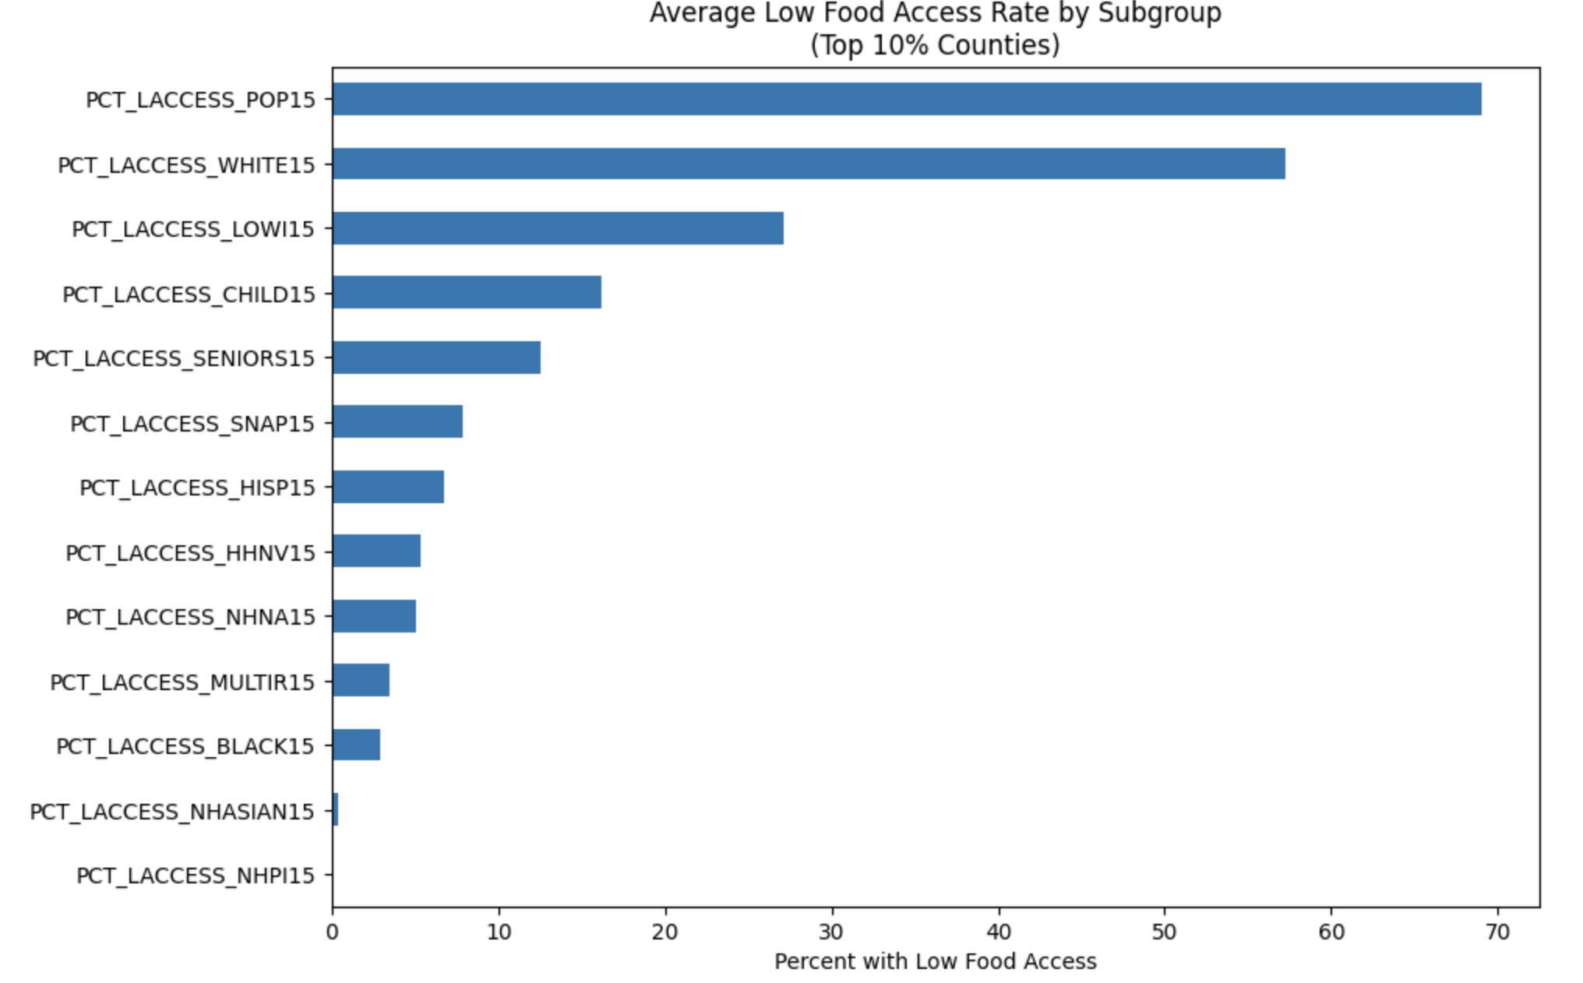
Subgroup Evaluation
For both percents and total counts, white subpopulation struggles the most with food access, with low-income groups following next.

Slide 10
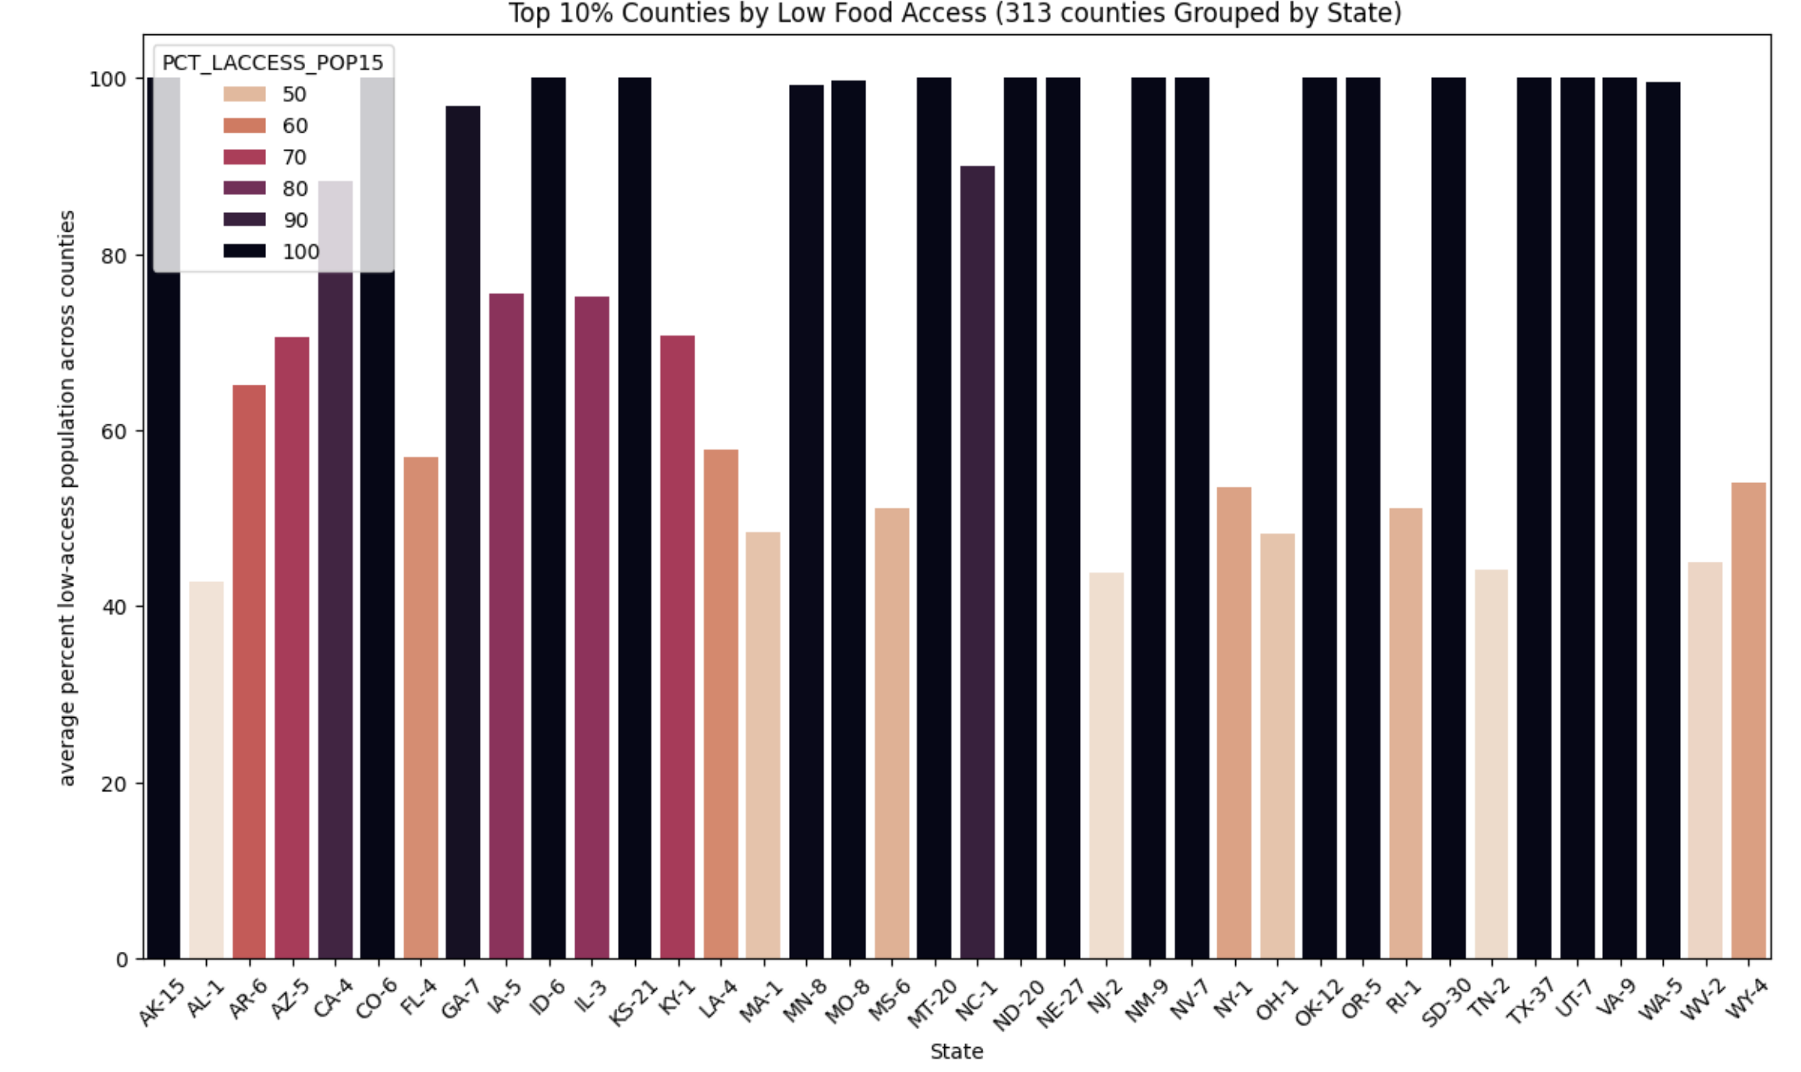
Plotting top 10% of Low Food Access Counties (313 total)
Total population count for this metric is about 2,545,992
Look for states with large concentration and larger count within counties.
TX, SD, NE, ND, MT, KS

Slide 11
Targeting further affected populations: Building a Health Issue Index
Lack of food access often leads to health issues caused by lack of nutritional food in combination with other unhealthy lifestyle habits.
We can assume those with nutrition-based health issues will have higher retention rates.
To quantify this target, we can use the 500 cities dataset. This dataset carries information regarding certain health indicators and their estimated 2017 crude prevalence rate at the tract level for 500 cities.
500 Cities health data captures adults only; child subpopulation is inferred as risk, not directly measured.
Our indicators will be overall physical health, obesity, high cholesterol, diabetes, and high blood pressure.
Rank tracts in percentiles for both.
We will look at top quartile in both measures.

Slide 12
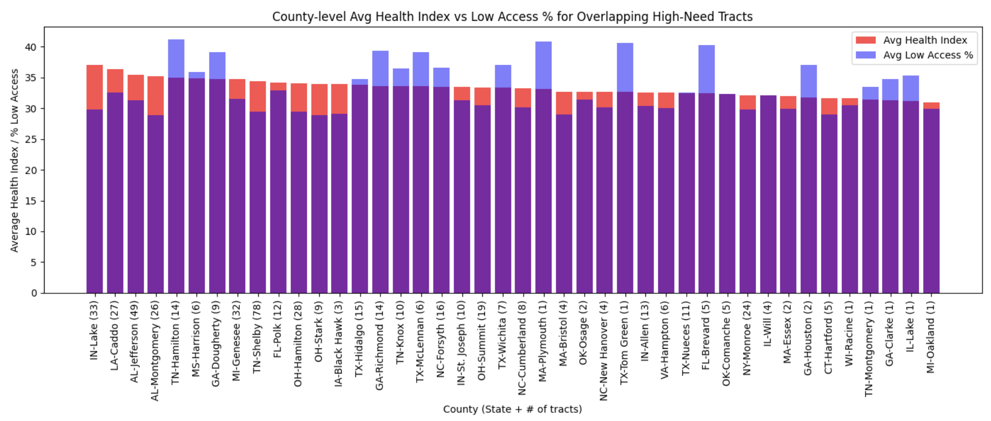
Top 10% Counties with high health indicator and high access need tracts.
Using health data shows trends for health and access issues in specific East/Southeastern regions as well.

Slide 13
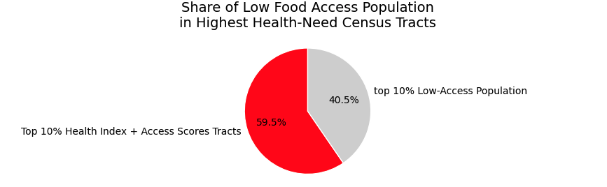
By targeting high health index areas, we also cover over half of the top 10% of the low access rate population.
Since health index may indicate retention ability, let’s assume a retention rate of about 50% of the high index population.
This gives us a total retention rate of around 18% if program deployed to top 10% low access rate populations.

Slide 14
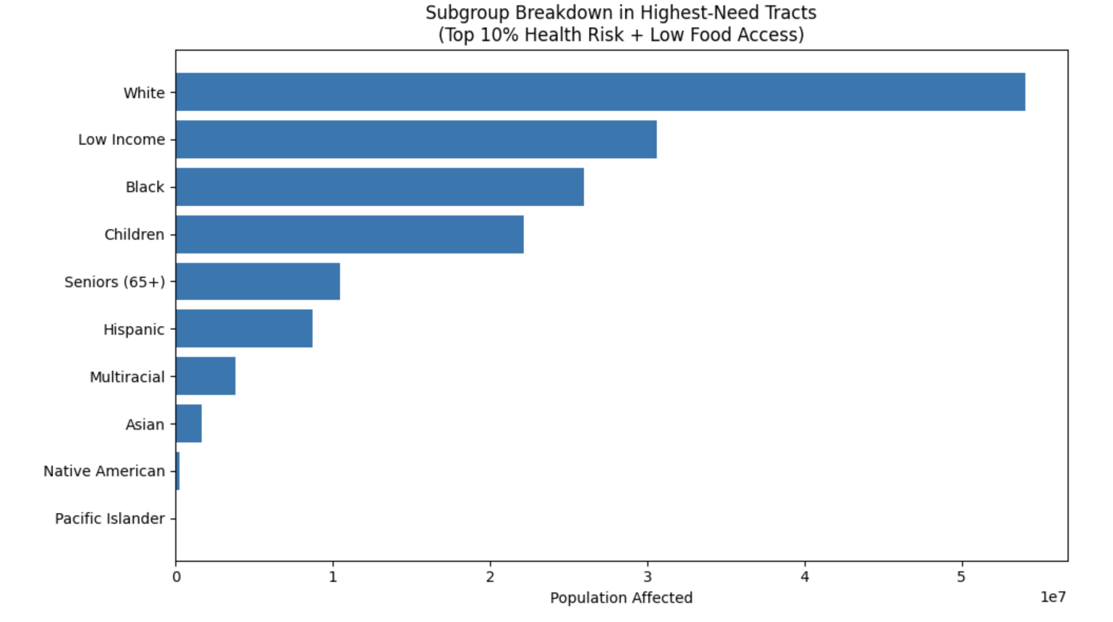

Slide 15
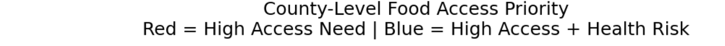
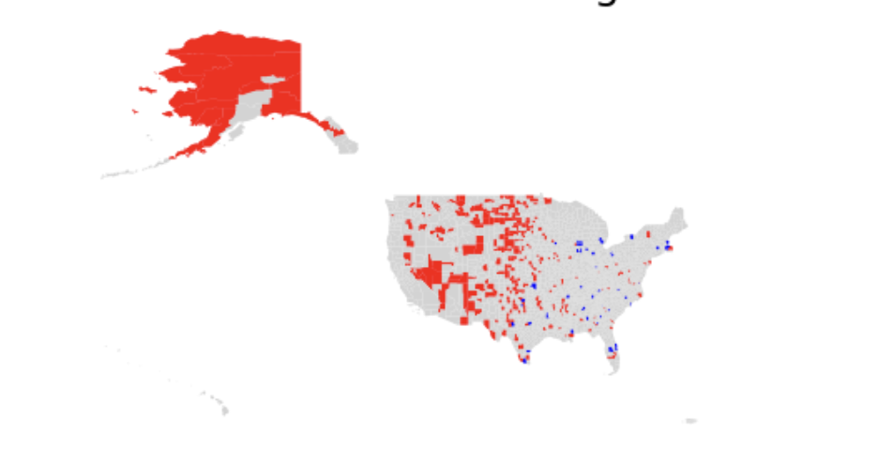
Aim to target all highlighted areas
Expect higher retention rates in blue areas due to health conditions, as well as Midwest regions due to extremely low access.
Health data coverage is incomplete. Red tracts without reported health data may also represent health risk areas.

Slide 16
Summary of Areas to Target and Projected Impact
Areas with high health overlap and just high percentage of low access
Check counts for these areas to get total number of projected impact
People with high overlap will probably have the most engagement.

